Slide 1
General Guidelines for Presentation
Slides should not be too heavy with content. Better to create point wise.
If you require more than one slide for any point, right click on that point slide then select duplicate slide and modify the duplicated slide.
Diagrams must be aligned at centre and clearly visible with caption.
All the mentioned fonts, font size, title content, etc should not change and strictly as per the given format and guidelines.

Slide 2

Title of your Project
Group members with StudentId
Vinayak Dhananjay Sharma :-21104097
Siddhi Shailesh Patole:21104079
Pranav Dinesh Patil:21104134
Kunal Sherbahadur Singh:21104127
Project Guide
Ms. Shital Agarwal

Slide 3
Contents
Introduction
Objectives
Scope
Features / Functionality
Project Outcomes
Technology Stack
Block Diagram if applicable

Slide 4
1. Introduction
Instagram automation is the use of third-party software or tools to manage your instagram account, carrying out tasks, and interacting with other users like you.
Tools for instagram auomation work in one of two ways. First there are services that take control of your follower-facing interactions (automating your likes and comment). Other tool focus on publishing, reporting and analytics.
Problem Identified :
Using instagram effectively means more than just posting a photo with a caption every now and again. To build a following engagement on instagram, You also need to spend time doing several other activities.
All these activities can easily add up to several hours a day, which is why there is such a high demand for Instagram automation tools.
Proposed :
Automation tools can do a lot of these tasks for you after some initial setup, which can be a significant time-saver.
Instagram automation tools are often priced very cheaply and are certainly more affordable than hiring a human to manage your account for you.tup, which can be a significant time-saver.

Slide 5
2. Objectives
To automate user interaction with Instagram.
To go through the posts one by one and then perform a set of tasks, which are liking, commenting, following and saving. To achieve these we will use selenium webdriver tools to perform browser interactions such as clicking, scrolling, and typing, etc.

Slide 6
3. Scope
Automation allows you to spend more time thinking about your instagram strategy and creating great content, and less time on chores like opening the app to post multiple times per day or combing through Insights.
The biggest waste of time on any app is constantly opening and closing it throughout the day to create and post new content. Being able to create multiple posts and Stories in advance, then scheduling them to post automatically at the ideal times, is a major time saver.

Slide 7
4. Feature /Functionality
Feature 1 : Services such that effectively “take control” of your front-facing interactions with users such as likes and comments
Feature 2 :
    Tools that automate Instagram behind the scenes, taking care of tasks such as publishing, reporting and analytics
    From automating posts to publish when your followers are most active to uncovering hashtags to expand your reach, you can absolutely automate pieces of your Instagram account without worrying about spam or a strike from the platform itself.
Feature 3 :
    With so much content floating around Instagram, anything you can do to reach followers when they’re most engaged is a plus and it queue the post to post it when followers are active..
    Instagram automation also publish it based on when your followers are most active.

Slide 8
5. Outcome of Project
Mentioned what will be the final output of project pointwise
e.g.
User Can log in
User can search for options available
Used can book ticket by providing following inputs
      -
And so on……

Slide 9
6. Technology Stack
Write what you have planned to develop front end ( GUI ) & Backend (Database if applicable)
- Instapy-Python
- Backend-selenium webdriver.

Slide 10
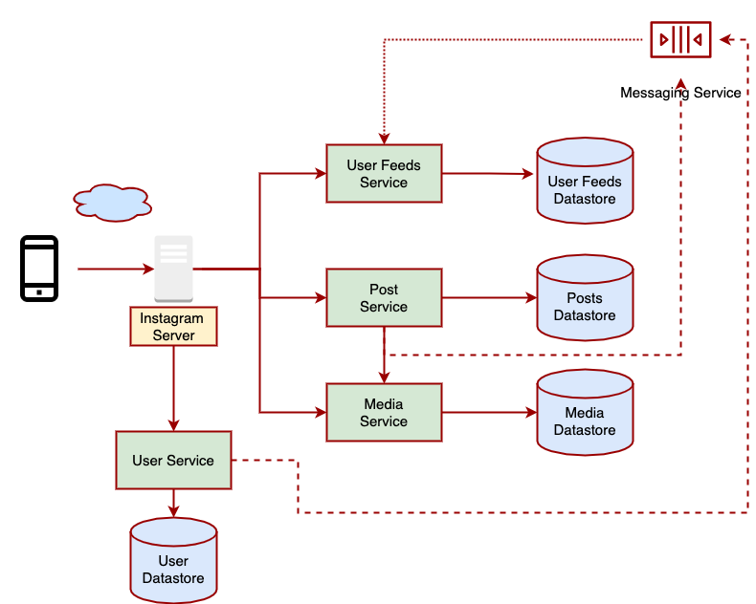
7. Block Diagram ( if applicable)

Slide 11
Thank You...!!

